Slide 1
Room 42 Experience
FIC – LILLE
© 2018 - SECURITYMADEIN.LU

Slide 2
Welcome!
Section 01 - Room42 – FIC Experience
Notes:
Small welcome speech.

Slide 3
Basic rules:
1 – This is a serious game
2 – This is an infosec crisis simulation
3 – Success depends on YOU
Section 01 - Room42 – FIC Experience
Notes:
Small welcome speech.

Slide 4
Ready?
Connect to https://survey.secin.lu
Section 01 - Room42 – FIC Experience
Notes:
Click on « I am ready », and click the next button.

Slide 5
Select your role!
Section 02 – Select your role
Notes:
You will now have to select your role in the company.
You have a choice of 3 main roles: HR, Communication and IT.
Please note that you do not have to be an expert in real life on the domain to succeed. This is, after all, a game,

Slide 6
ToyCo?
Section 03 – Presentation video
Notes:
You will now have to select your role in the company.
You have a choice of 3 main roles: HR, Communication and IT.
Please note that you do not have to be an expert in real life on the domain to succeed. This is, after all, a game,

Slide 7

Notes:
Welcome my friends. Welcome to my world. You are about to embark on a journey to the everyday reality of the cyber age. You all are employees of an almost 100 year old company. ToyCo, a family business, which was created in 1932 by producing it’s original star product: the Teddy plush. A real success, it allowed the firm to go worldwide. But the world changes. As production costs got higher, new actors entered this market. The traditional family values upon which the firm has stood has allowed it to keep the business running. The structure of the company evolved though, and in 1976 it went public while keeping family control over the capital. Now the toys that attracted kids some decades ago unfortunately are not here to stay. As technology impacted the toy market, ToyCo almost died. 3 years ago, a new shareholder acquired the last remaining shares from the original holders and invested in the production of a new range of connected toys. They were the Cyber Teddy. Cuddly and easy to use, these connected toys rely on the cloud. Of course, the budget for this development was tight. Focus was made on the essential functionalities. But it worked. Combining the historical attraction to the brand with modern technology was apparently the move the company needed to reinvent itself and redefine the toy maker market for the digital age. So welcome my friends. Now start working. Your future is bright. Please look at your role and profile - you will be playing this person. Have fun.

Slide 8
Time to work!
Section 04.a – The digital coal face
Notes:
Click on the link to start your daily routine. A mail has to be send asap.
REMINDER: Do not close any tabs of your browser!

Slide 9
Self evaluation!
Section 04.b – This might impact your bonus
Notes:
Click on the link to start your daily routine. A mail has to be send asap.
REMINDER: Do not close any tabs of your browser!

Slide 10
Video
Breaking News
Section 05 – This might hurt
Notes:
A breaking news just in!

Slide 11

Notes:
This is just in - It looks like it might be a not so Merry Christmas for one of the regions main employers, ToyCo. The so-called "Ethical Hacking Group" have released a statement on a webpage popular with hackers called Pastebin, alleging a major data breach involving ToyCo's flagship CyberTeddy range of Internet connected toys. The group claims that they have access to a database for the product and can see images and listen to audio - uploaded by kids. We have contacted ToyCo but recieved no comment from them at this time...

Slide 12
Presentation
Data breach?
Section 06 – Basic facts
Notes:
A breaking news just in!

Slide 13
Databreach?
Security failure | Information leak
Embarrasment | Trust issue
Consequences
Section 06 – Basic facts
Notes:
A databreach is a security failure, which is identified as an information leak.
It is a strong source of embarrasment for to organization that is responsible.
It generates strong trust issues within the organization ecosystem (clients, partners, competitors, …).
Consequences can be huge, at multiple levels (from legal to economical and communicationnal).

Slide 14
Databreach?
i.e.
An organizational Tsunami
Section 06 – Basic facts
Notes:
Impact can be massive. You better be ready.
Impact will depend on nature of the breach.

Slide 15
Video
A request
Section 07 – Vultures Gather
Notes:
A Reporter wants some information!

Slide 16

Notes:
Good day. I am a reporter for the National Press Journal, and have a few questions regarding the recent hacking claim involving ToyCo. Thank you for contacting me as soon as possible.

Slide 17
Discussion time!
Section 08 – Time for a meeting
Notes:
Do not forget to check your screen, some specific details might be displayed.
Next slide has a timer… Players will only get one minute!
It seems that ToyCo is not at all complient with GDPR obligations…

Slide 18
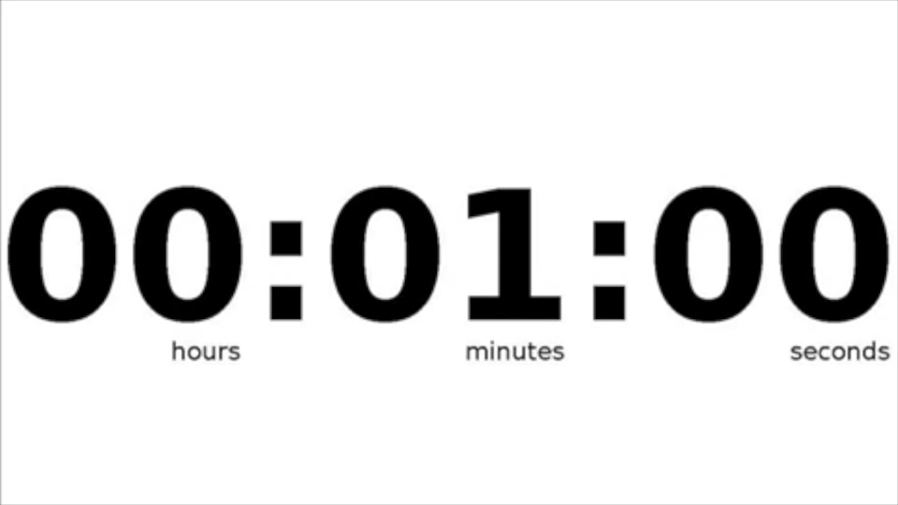
Notes:
Players should not forget to check their screens, some specific details might be displayed.

Slide 19
Vote for your choice of action!
Section 09 – Individual choices
Notes:
What would you do?

Slide 20
Breaking News!
Section 10 – Yet another event with consequences
Notes:
Seems your CEO is on the radio!

Slide 21
Notes:
I can categorically confirm that there has been NO, I repeat, NO data breach at ToyCo.
As a traditional family company, for over 80 years, our primary concern is and has always been, the safety and privacy of our customers.
This so-called news is just another example of a criminal hacker trying to become famous and spread fear, along with the collusion of the press in this FAKE NEWS.

Slide 22
Presentation
The first stage of data breach grief
Section 11 – You will not like that
Notes:
A breaking news just in!

Slide 23
Denial
A Breach is an emotional shock, and public denial is far to often the first public reaction
Section 11 – You will not like that
Notes:
Key word is behavioral irrationnality

Slide 24
Discussion time!
Section 12– Crisis management
Notes:
How should that crisis be managed from now on?
It really seems that ToyCo is not at all complient with GDPR obligations…

Slide 25
Notes:
Players should not forget to check their screens, some specific details might be displayed. There is a real option here for role playing.

Slide 26
Vote for your choice of action!
Section 13 – Individual choices
Notes:
What would you do?
Should you seek external help?
What are the risks?

Slide 27
Presentation
Data breach management
Section 14 – Failure might be an option
Notes:
A breaking news just in!

Slide 28
Key questions:
How do we treat vulnerability reports?
Importance of vulnerability disclosure policy…
How should we react?
Importance of a disaster recovery plan
Section 14 – Failure might be an option
Notes:
Key word is behavioral irrationnality

Slide 29
Breaking News!
Section 15 – Why deny if cauht red handed?
Notes:
Diffusion of false or misleading informations can and most certainly will fire back…

Slide 30
Notes:
"Latest news. The Hackers identified as the Ethical Hacking Group have just released the following statement."
"We are EHG, and here we go again ToyCo edition! Again and again the same things happen. You in your corporate tower ToyCo, you see OUR data as your oil. You pervs now even put cameras in the bedrooms of kids, pushing their souls online for your profits. AND YOU DON'T EVEN PROTECT IT!! Your lying CEO denies all and says we are making "FAKE NEWS". Here is some real news Mr. LYING CEO. Here are some pictures from your servers. Lets listen to this kid, should we?"
"Video-sample toyco.io/?watch?v=z464K6xVdtM"
"We told the world that You, ToyCo and your "Cyber Teddy" take kids intimate moments and leave them lying around on the interwebz for anyone to abuse. WE NOW HAVE TAKEN CONTROL OF THAT DATA, YOU HAVE BEEN PWNED. LOL. AND YOU SAY WE LIE. You do not deserve the data nor sympathy. EHG can haz all your Cyber Teddy stuff: data, video, pix, audio. We are Ethical but You were warned and denied all. Yes, dear viewer, dear ToyCo, we are EHG."

Slide 31
Discussion time!
Section 16 – Anger on the horizon
Notes:
Do not forget to check your screen, some specific details might be displayed.
Next slide has a timer… Players will only get one minute!
It seems that ToyCo is not at all complient with GDPR obligations…

Slide 32
Notes:
Players should not forget to check their screens, some specific details might be displayed. There is a real option here for role playing.

Slide 33
Breaking News!
Section 17 – What now?
Notes:
Diffusion of false or misleading informations can and most certainly will fire back…

Slide 34
Notes:
Hacker group claims of a data breach at ToyCo, which the company CEO dismissed as "fake news", appear to have been correct. The so-called Ethical Hacking Group have released a video in the wake of the ToyCo statement, showing anonymised pictures of children said to be found in an insecure company server, along with files which an independent security researcher has verified. We contacted the Data Protection Agency for a statement and they said that they "are aware of the allegations of a data breach at ToyCo, are taking them seriously and are looking into the issue". The consumer watchdog has also said they are following the story, which could seriously affect ToyCo sales in the run up to the vital Christmas period.

Slide 35
Presentation
Data breach & organizational issues
Section 18 – Failure might be an option
Notes:
A breaking news just in!

Slide 36
Requirements:
Importance of organizational readiness
DPO
Inventory of data sets (what, why, where, with whom, …)
Legal framework & GDPR compliance
Section 18 – Failure might be an option
Notes:
Key word is behavioral irrationnality

Slide 37
Discussion time!
Section 19 – Depressive times
Notes:
Do not forget to check your screen, some specific details might be displayed.
Next slide has a timer… Players will only get one minute!
It seems that ToyCo is not at all complient with GDPR obligations…

Slide 38
Notes:
Players should not forget to check their screens, some specific details might be displayed. There is a real option here for role playing.

Slide 39
Vote for your choice of action!
Section 20 – What now?
Notes:
What would you do?
Should you seek external help?
What are the risks?

Slide 40
Conclusion
Section 21 – There is hope
Notes:
Diffusion of false or misleading informations can and most certainly will fire back…

Slide 41
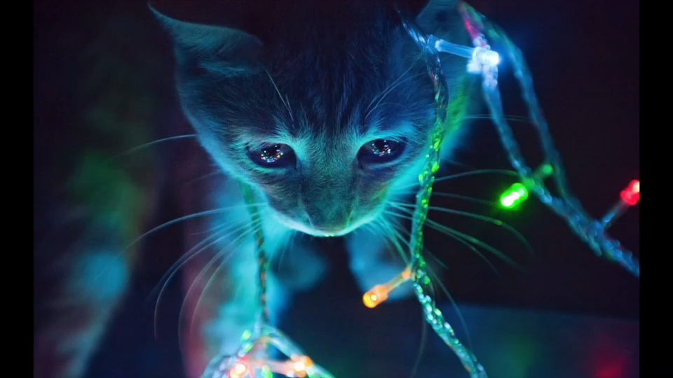
Notes:
« It's time to accept what has happened and try to move on. The story continues, but we shall not know if ToyCo will survive this crisis or not, or what could have been done... But maybe you have a clue? »

Slide 42
Presentation
Data breach grief
Section 22– the 5 stages
Notes:
A breaking news just in!

Slide 43
Step 1 – Denial (lying compulsively)
Step 2 – Anger (bite back whoever is there, with streisand effect bonuses)
Step 3 – Bargaining (time to deal with the truth)
Step 4 – Depression (assuming the consequences of the truth)
Step 5 – Acceptance (give the answer victimes deserve)
(source: Troy Hunt)
Section 22 – the 5 stages
Notes:
Key word is behavioral irrationnality

Slide 44
Room 42 experience
ToyCo Chapter (data leak)
Original story idea by Matthieu Farcot & Chris Pinchen
©2018 C3 c/o Securitymadein.lu
Licensed under CC BY SA 4.0
Notes:
A breaking news just in!

